Slide 1

SYLVAN RUSH : 3D ENCHANTED FOREST ENDLESS RUNNER
A Capstone Project report submitted in partial fulfilment of requirement for the award of degree
BACHELOR OF TECHNOLOGY
in
SCHOOL OF COMPUTER SCIENCE AND ARTIFICIAL INTELLIGENCE
By
1) SAI SUNKARI - 2303A52492
2) SUSHANTH BOLAGANI - 2403A52L11
3) CH. CHARAN KUMAR - 2303A54006
Under the guidance of
Dr. VIJAYA CHANDRA JADALA
Assistant Professor, School of CS&AI.
SR University
Ananthasagar, Warangal, Telangana-506371
2026-2027

Slide 2
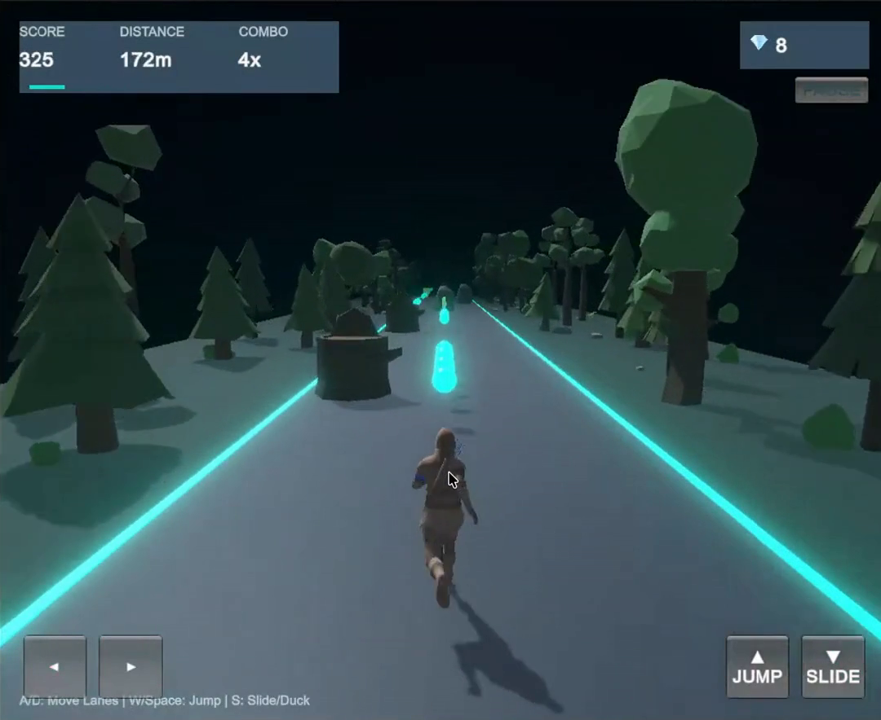
01 / GAME CONCEPT
A mystical woodland runner. High-speed precision.
A fast-paced 3D endless runner built around quick decisions, collectible rewards, and escalating challenge.
PROJECT IDENTITY
GAME WORLD
Guide a swift woodland runner through an infinite enchanted forest.
Auto-forward sprint with responsive 3-lane lateral Lerp.
Leap cleanly over Woodland Stumps; dodge Ancient Monoliths.
Collect glowing Mana Orbs for score combos and active blessings.
Face procedural track hazards and dynamic speed escalation.
UNITY 6 (URP) + C#
DESKTOP
MOBILE
Keyboard input • On-Screen Touch D-Pad

Slide 3
01 / GAME CONCEPT
Six pillars shape the experience
The project combines accessible controls with layered challenge, atmospheric world-building, and modular game systems.
01
Instant accessibility
02
Reflex-based movement
03
Atmospheric fantasy
Crisp pre-game title card introduces Controls, Hazards & Blessings upfront.
Smooth 3-lane shifting, 3.33m jump clearance, and fast-fall ducking.
Bioluminescent flora, volumetric mist, glowing runes, and woodland ambience.
04
Replayability
05
Combo & Blessing Economy
06
Modular engineering
Distance goals, dynamic combo multipliers, and personal best records.
Mana Orbs scale combo multipliers; 3D Spirit Blessings grant invulnerability.
Decoupled C# architecture: GameManager, PlayerController, and Spawners.

Slide 4
01 / GAMEPLAY DESIGN
The core loop: run, react, power up, combo score
Distance and Mana Orb chains drive the score multiplier as player navigates procedural hazards.
01
02
03
04
05
›
›
›
›
RUN
GATHER
CLEAR
BUFF
ESCALATE
Auto-forward motion
Mana Orbs & Buffs
Stump leap / Rock dodge
Shield / Dash / Magnet
Higher speed & combos
PLAYER OBJECTIVES
01
Travel farther
02
Chain Mana Orbs
03
Clear balanced hazards
04
Beat the record
Run score and lifetime records are reflected in the HUD and persistent player data.

Slide 5
01 / PROGRESSION
Dynamic difficulty progression & blessing mechanics
The pacing model starts with accessible patterns and scales speed while enforcing safe navigable lanes.
DIFFICULTY PHASES
SPIRIT BLESSING SYSTEM
0–500 m
INTRODUCTION
MANA ORB
+100 pts + Combo
Base speed · single Woodland Stump & Boulder hazards
Master 3-lane lateral Lerp, jump timing, and ducking.
BARK SHIELD
14s Buff (1 Hit Absorb)
500–1,500 m
RISING PRESSURE
3 Orbiting emerald-gold shields protect player
Accelerated speed · alternating hazard patterns
Tighter reaction windows requiring rapid lane shifts.
POWER-UPS
1,500 m+
HIGH INTENSITY
Spirit Magnet: Pulls Mana Orbs across all 3 lanes (8.5s).
High velocity · rapid multi-lane hazard sequences
Wind Dash: 5s invulnerable supersonic turbo sprint + dynamic FOV.
Procedural safety rule guarantees at least one clear lane.
3D POWER-UP SYMBOLS

Slide 6
02 / UNITY ARCHITECTURE
Built on Unity 6 with modular C# architecture
The architecture separates scenes, reusable assets, gameplay scripts, presentation, and saved player data.
CORE TECHNOLOGY
PROJECT FOLDER ARCHITECTURE
ENGINE
Unity 6 (6000.x) LTS
›
Assets/Scenes/
SylvanRush Gameplay Scene with Title Card overlay
RENDERING
Universal Render Pipeline (URP)
›
Assets/Scripts/
GameManager · PlayerController · ObstacleSpawner · PowerUpManager · GameUIManager
GAME LOGIC
C# scripts and Unity components
›
Assets/Prefabs/
Woodland Stump · Ancient Boulder · Mana Orbs · 3D Power-Ups
CAMERA
CameraFollowShake (Dynamic FOV & impact shake)
›
Assets/Materials/
Moss · Bark · Glowing runes · Stone
UI
Native OnGUI Title Card & HUD
›
Assets/Audio/
Ambience · Footsteps · Pickups · Crash SFX
PERSISTENCE
PlayerPrefs personal best score & distance
›
Assets/VFX/
Orbiting shields · Dash trails · Mana Orb collection sparkles
The project structure supports reusable prefabs and decoupled responsibilities across the game.

Slide 7
02 / SCENE DESIGN
Seamless state machine: Title Card to Game Over
Unified game state machine manages Title Card, active run HUD, Pause menu, and Game Over overlays.
01
02
03
04
MAIN MENU
›
ACTIVE RUN
›
PAUSE MENU
›
GAME OVER
Entry point
Run summary overlayner flow
In-game suspension
Run summary overlay
Play button · title · saved records
Live HUD: Score, Distance, Combo decay, Orbs, Buffs
Instant Resume or Restart Run
Final score, meters, mana orbs, and personal best
PRE-GAME TITLE CARD
Title card (530x490px) rendered natively before run starts, explaining Controls, Hazards & Powers.
The state transition sequence is Title Screen → Active Gameplay → Pause / Game Over.

Slide 8
02 / WORLD PROGRESSION
Atmospheric world design & procedural streaming
Immersive woodland environment built with URP lighting, atmospheric fog, and runtime tile recycling.
01
02
03
ENCHANTED FOREST
VOLUMETRIC ATMOSPHERE
PROCEDURAL STREAMING
DEFAULT · UNLOCKED
NIGHT FOREST PALETTE
OBJECT RECYCLING POOL
Ancient mossy pathways, glowing flora, fallen logs, and the starting challenge.
Deep teal ambient mist, moonlit directional shadows, and luminous bioluminescent flora.
Continuous track generation ahead of player with automated recycling behind the camera.
BASELINE
URP LIGHTING
ZERO GC DROPS

Slide 9
03 / PLAYER CONTROLS
Three lanes. Responsive reflex physics.
Smooth lateral Lerp physics paired with calibrated jump apex and fast-fall ducking.
THREE-LANE TRACK
INPUT MAPPING
LANE SHIFT
A
D
←
→
Desktop: A / D or Left/Right · On-Screen: Virtual Touch D-Pad (Lerp speed = 16f)
JUMP
SPACE
↑
Jump velocity = 15.5f, gravity = 36f, apex = 3.33m. Clears 2.8m stumps cleanly.
PLAYER
SLIDE
S
↓
LEFT
CENTER
RIGHT
−3 m
0 m
+3 m
Shrinks CharacterController height to 0.9m for rapid recovery and fast-fall.
The pre-game title card introduces controls and mechanics directly before the run starts.

Slide 10
03 / GAMEPLAY SYSTEMS
Balanced hazard design and 3D spirit blessings
Ground obstacles calibrated for fair jump and dodge responses; custom 3D pickups reward active play.
01
WOODLAND TREE STUMP
02
ANCIENT STONE MONOLITH
COLLECTIBLES & BLESSINGS
VAULT / LEAP
Scaled 2.8m obstacle cleanly vaulted with 3.33m jump.
DODGE / LEAP
Massive 2.95m boulder: dodge sideways or precision leap.
MANA ORBS
+1 score
SPIRIT MAGNET
+5 score
Pulls all orbs (8.5s)
03
BRANCH ARCH REMOVAL
04
3D SPIRIT BLESSINGS
Bark Shield: 3 orbiting emerald-gold shields absorb 1 hit (14s).
FAIR PLAY
Branch arch removed after playtesting to prevent visual clutter.
VAULT / LEAP FAST
Horseshoe Magnet, Bark Shield & Wind Dash at 1.85x scale.
Wind Dash: 5s invulnerable supersonic turbo sprint + dynamic FOV.
LIVE HUD
MANA ORBS • SPIRIT MAGNET • DISTANCE (m)
Real-time OnGUI HUD displays score, meters, combo timer decay gauge, and active buff badges.

Slide 11
04 / WORLD GENERATION
Procedural track streaming & safety validation
Continuous forward track streaming with dynamic obstacle spawning and guaranteed safe passage.
01
02
03
04
05
PREFAB CATALOG
›
LANE SAFETY CHECK
›
PLACE AHEAD
›
ADAPTIVE CADENCE
›
RECYCLE
Track and obstacle variants
Guarantees >= 1 safe lane
Advance Z ahead dynamically
Scales with player velocity
Pool old segments
GENERATION LOGIC
3.0 m
LANE SPACING
Track segments and hazards are recycled in memory.
Spawner enforces balanced 50/50 ratio between Stumps and Monoliths.
50 / 50
STUMP / ROCK RATIO
Segments and hazards behind camera are immediately returned to pool.
The reference implementation uses SegmentGenerator.cs with a prefab array and coroutine-based spawning.

Slide 12
04 / C# IMPLEMENTATION
Inside the spawner: ObstacleSpawner.cs
Dynamic hazard spawning balances Woodland Stumps and Ancient Monoliths while enforcing lane safety.
UNITY C#
HOW IT WORKS
using System.Collections;
using UnityEngine;
public class ObstacleSpawner : MonoBehaviour
{
[SerializeField] private GameObject stumpPrefab;
[SerializeField] private GameObject monolithPrefab;
private float spawnZ = 30f;
void Update()
{
SpawnObstacleRow(spawnZ); spawnZ += 28f;
}
void SpawnObstacleRow(float z)
{
int safeLane = Random.Range(0, 3); // Guaranteed safe path
for (int lane = 0; lane < 3; lane++) {
if (lane == safeLane) continue;
if (Random.value < 0.65f) SpawnHazard(lane, z);
}
// 50/50 balance between Stump & Monolith
// Overhead branch arch removed for visual clarity
}
}
01
Guard
Guarantees at least one lane is completely clear for the player.
02
Balanced Mix
50/50 balance between Woodland Stump and Ancient Monolith.
03
Fair Clearance
Overhead branch arches removed to prevent unfair lane blocking.
04
Memory Pooling
Recycles passed obstacles to prevent garbage collection frame drops.
05
Dynamic Pacing
Hazard spacing tightens dynamically as player speed increases.
ObstacleSpawner guarantees responsive, skill-rewarding procedural lane navigation.

Slide 13
04 / C# IMPLEMENTATION
Decoupled C# architecture and gameplay coordination
PlayerController, ObstacleSpawner, PowerUpManager, and GameUIManager collaborate via clean events and singleton state.
PLAYER CONTROLLER / C#
SYSTEM RESPONSIBILITIES
void Update()
{
// Smooth 3-Lane Lerp: laneWidth = 3.0m, speed = 16f
float targetX = (currentLane - 1) * laneWidth;
transform.position = Vector3.Lerp(transform.position, target, Time.deltaTime * 16f);
// Jump Apex ~ 3.33m clears 2.8m obstacles cleanly
if (isGrounded && jumpRequested) verticalVelocity = 15.5f;
verticalVelocity -= 36f * Time.deltaTime; // Snappy gravity
}
PlayerController.cs
3-Lane Lerp · jump physics (15.5f) · slide · 3 orbiting shields
ObstacleSpawner.cs
Balanced Stump/Monolith spawning · safe lane validation
PlayerController.cs
3D custom mesh pickups · active buff timers · rotational float
GameManager.cs
State machine (Title/Play/Pause/Over) · score combo multiplier
GameUIManager.cs
Native OnGUI Title Card (530x490) · HUD with combo decay · D-Pad
PlayerController.cs
Scripts operate in harmony to provide an arcade-smooth, 60 FPS endless runner experience.

Slide 14
05 / PLAYER STATE
Records persist beyond a single run
PlayerPrefs stores personal best score and distance; dynamic combo multiplier decays in real time.
SAVE / LOAD FLOW
GAME OVER / REVIVE
01
LOAD
Start reads saved values
A run ends. The player chooses what happens next.
REVIVE
PLAY AGAIN
Instant retry button reloads gameplay and resets session counters.
02
TRACK
Session score, distance, mana orbs, combo multiplier
03
TRIGGER
Run ends; checks and updates personal best records
TITLE CARD
Live Indicators to Title
Re-open pre-game briefing with Controls, Hazards & Powers.
04
WRITE
PlayerPrefs.SetInt + Save()
REAL-TIME HUD
Live Indicators
Combo gauge decays smoothly unless sustained by Mana Orbs.
Stored keys
BESTSCORE · BESTDISTANCE · ORBSGATHERED

Slide 15
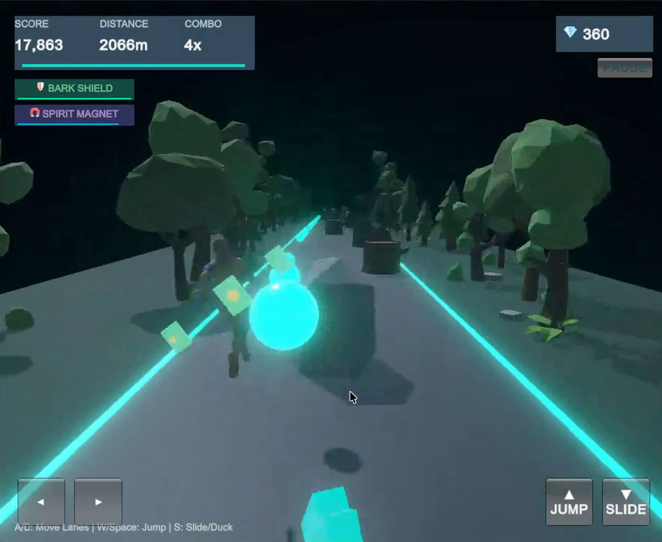
05 / EXPERIENCE DESIGN
A forest that feels alive
Lighting, animation, camera movement, and sound work together to make pickups, hazards, and transitions readable.
VISUAL LANGUAGE
URP LIGHTING
Warm directional sunlight, bloom, color grading, and subtle vignette.
CAMERA
CameraFollowShake with smooth follow, speed FOV warp, and collision shake.
ANIMATION
Sprint, jump vault, slide crouch, and shield impact visual feedback.
PARTICLE VFX
3 Orbiting emerald-gold shields, Wind Dash trails, and Mana Orb sparkle bursts.
SOUND DESIGN
Mana Orb chimes · Magnet hum · Dash whoosh · Shield break · Woodland ambience
IMMERSIVE FEEDBACK

Slide 16
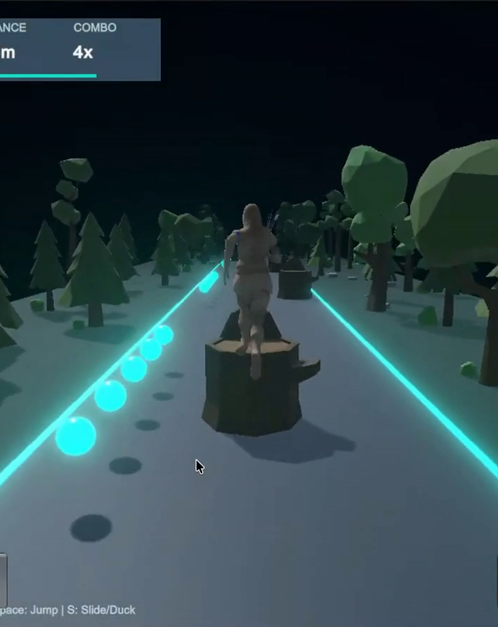
PROJECT SUMMARY
From a simple run
to a living world.
Sylvan Rush delivers responsive 3-lane gameplay, calibrated 3.33m jump clearance, 3D power-up symbols, and an atmospheric woodland setting.
Decoupled C# architecture with robust physics, lane safety validation, and combo decay mechanics.
Balanced hazard spawner with 50/50 Stump/Monolith distribution and zero runtime GC spikes.
Native OnGUI pre-game title card (530x490) and polished HUD with real-time combo decay bar.
FUTURE ENHANCEMENTS
Global online leaderboards · Procedural weather effects · Additional character classes and abilities
THANK YOU
Sai Sunkari • Sushanth Bolagani • Ch. Charan Kumar
16

